Slide 1
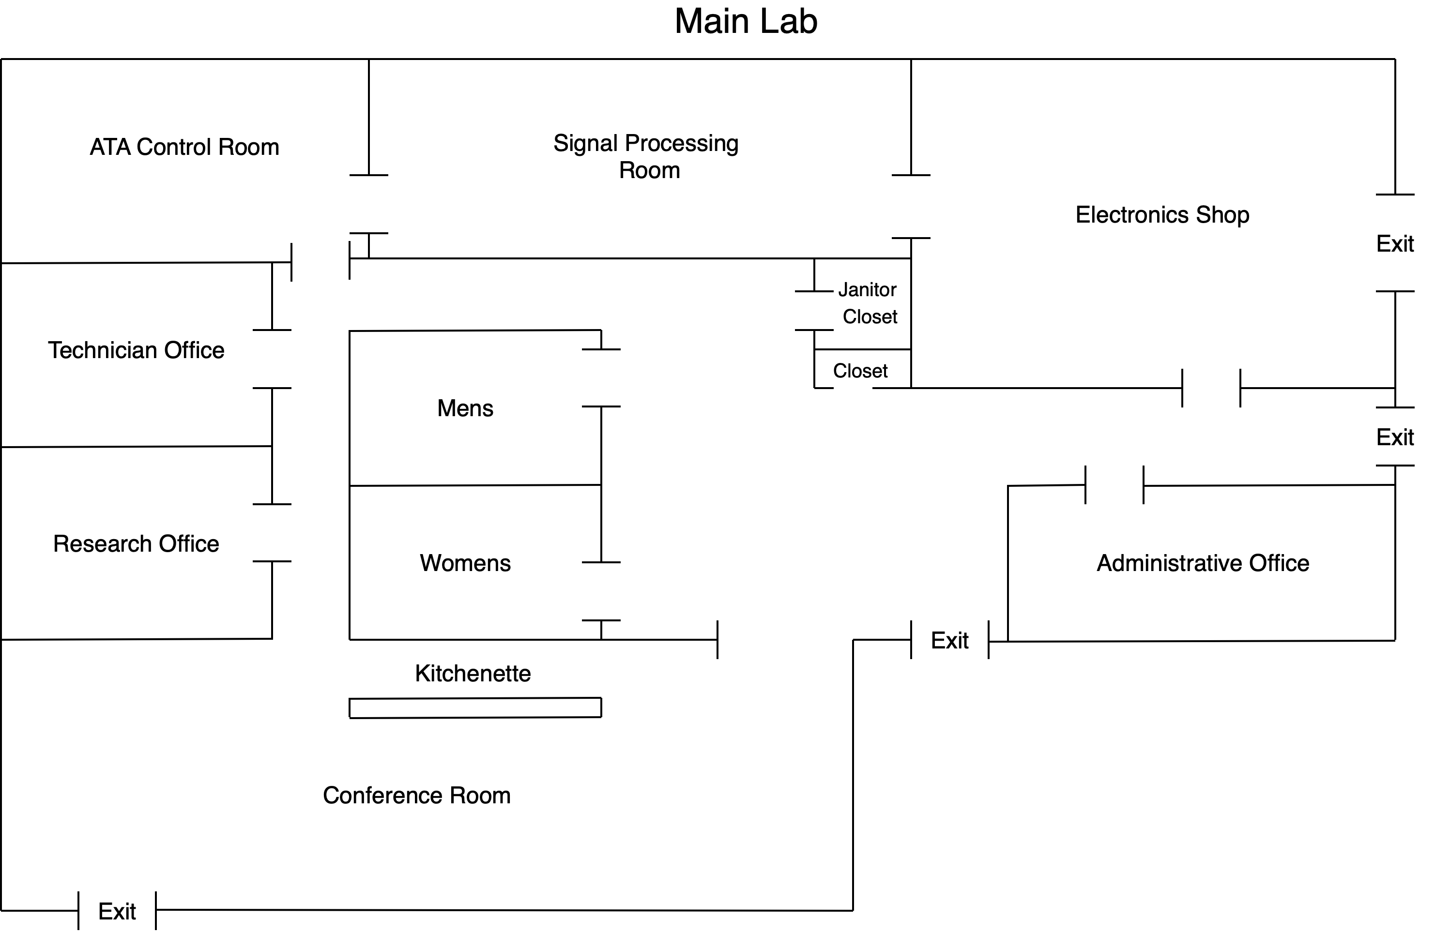

Slide 2
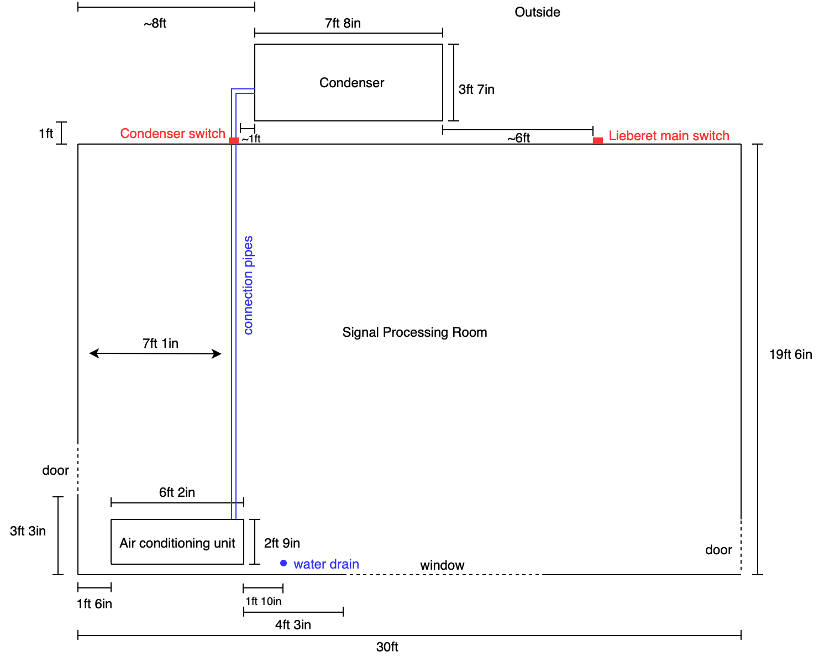

Slide 3
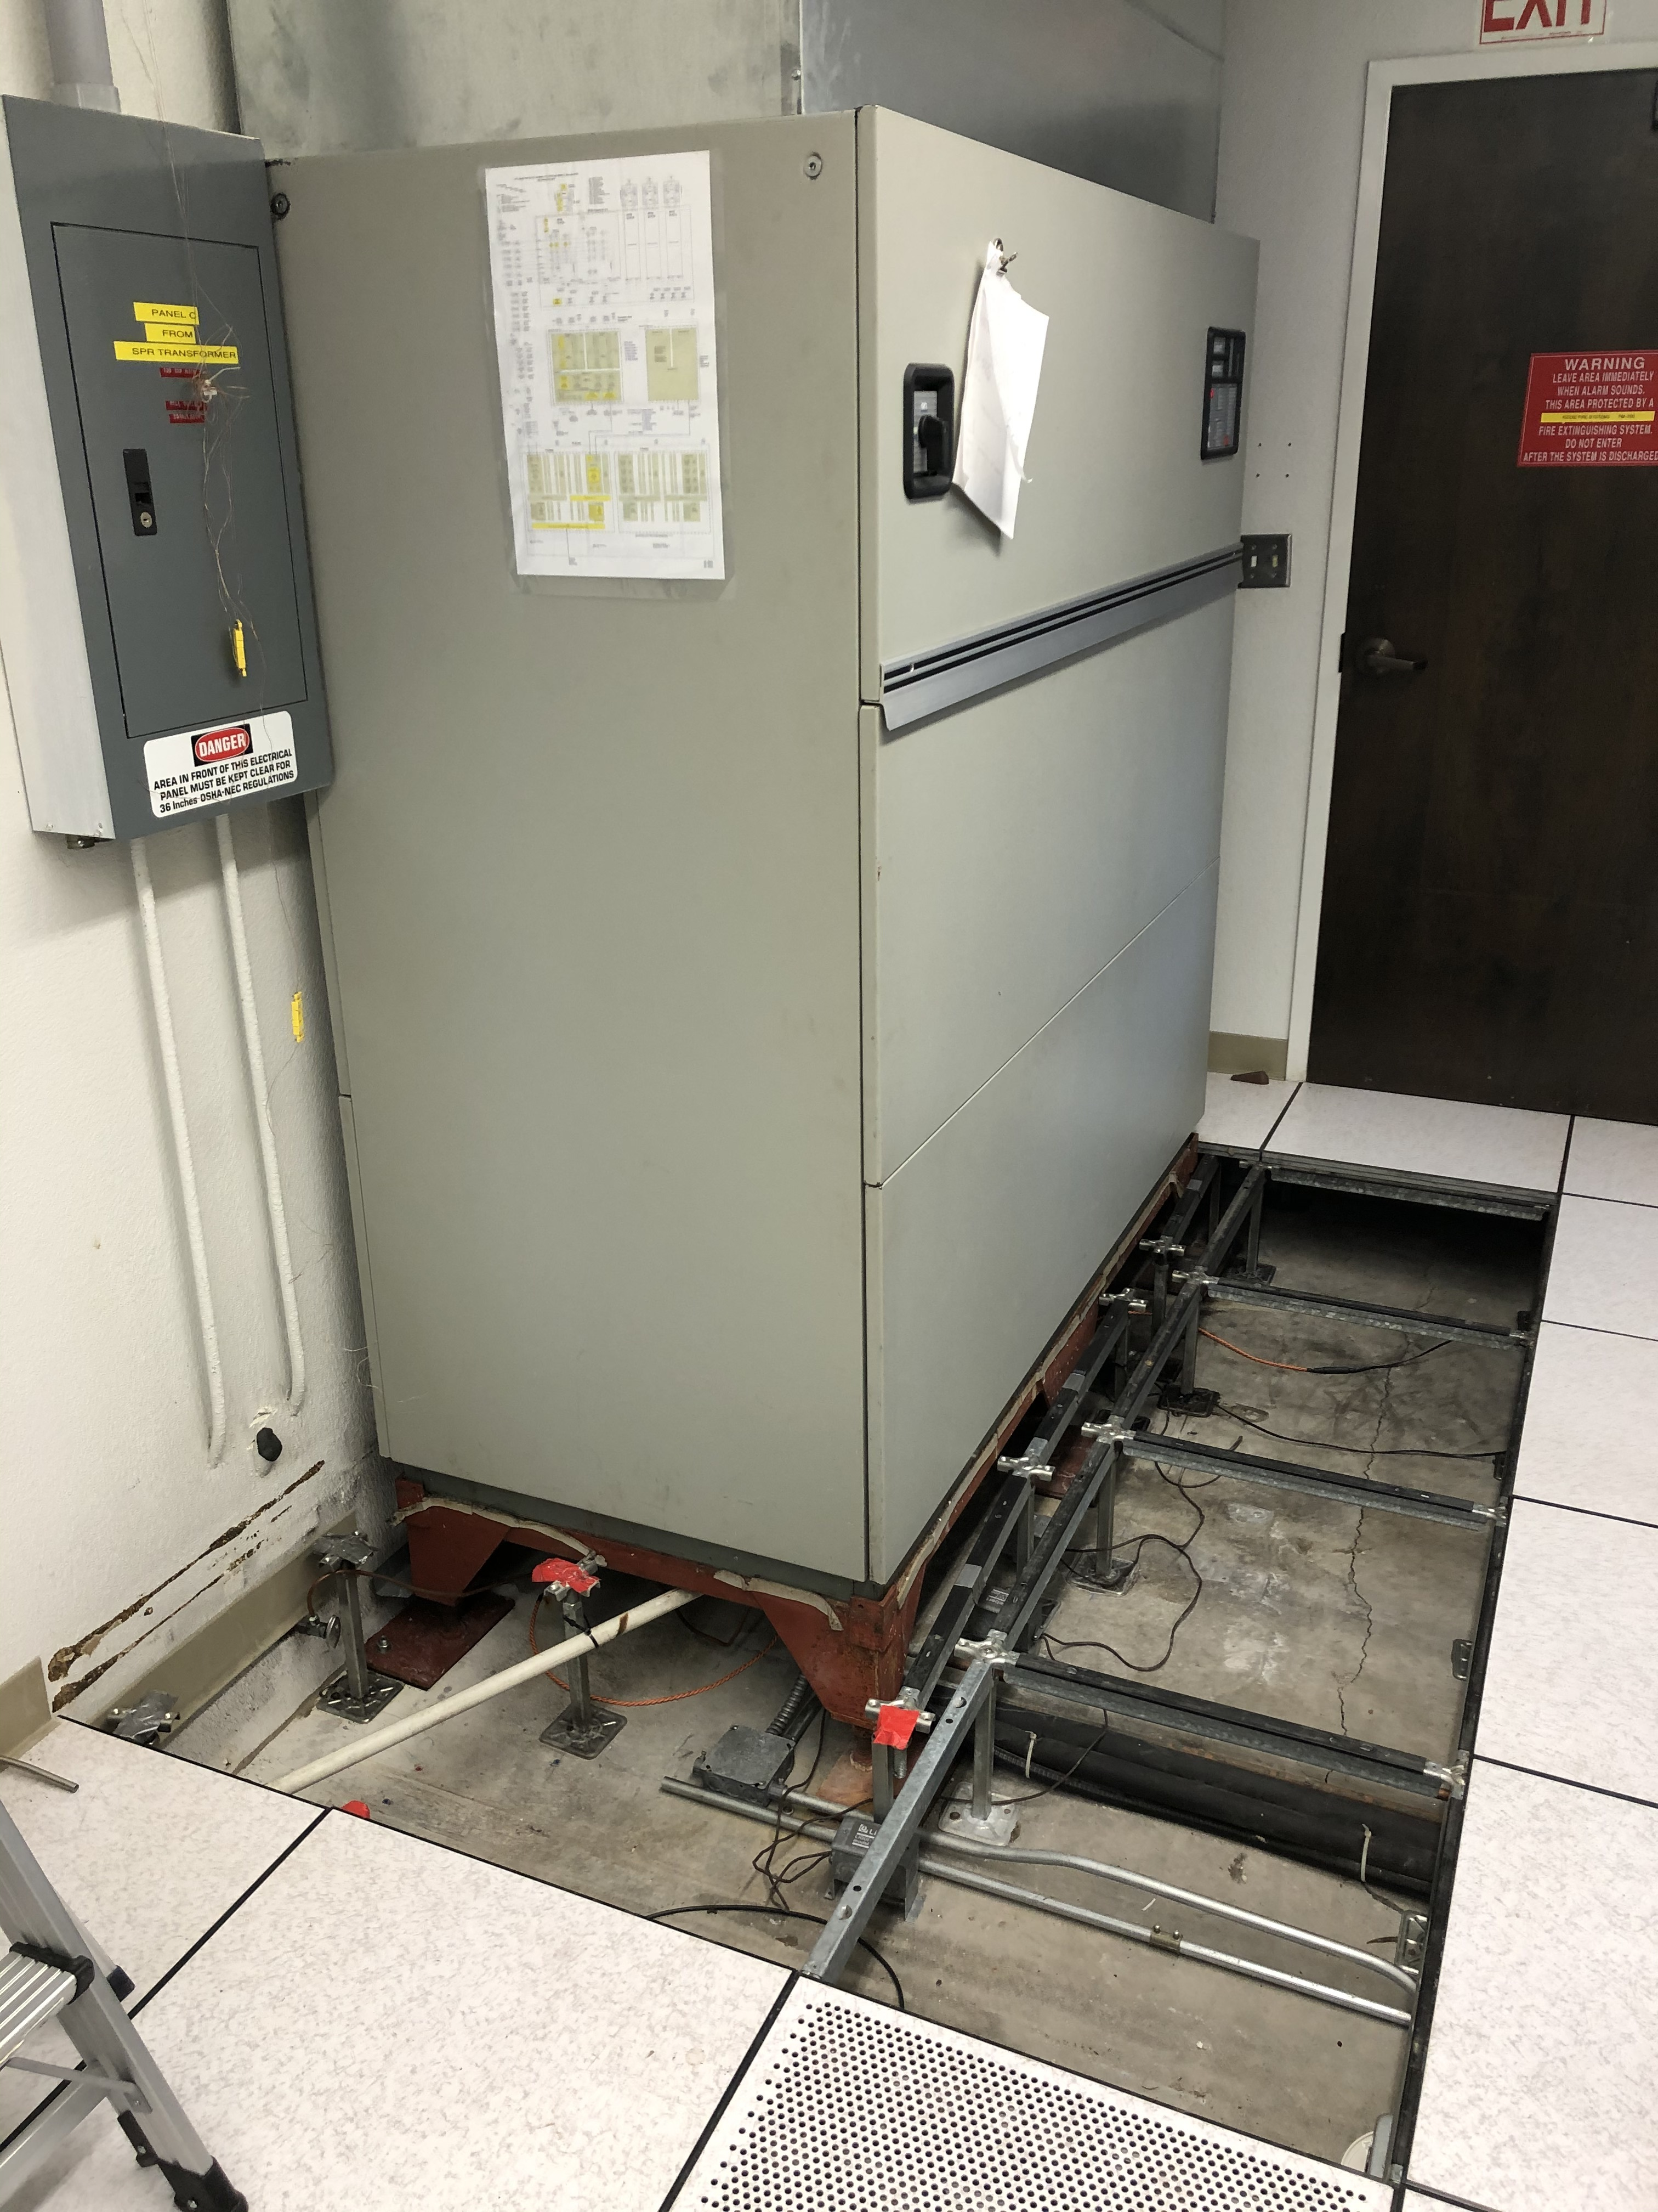
11inches between raised floor and cement foundation
Pipes that connect to the compressor outside
Pipe to water drain

Slide 4
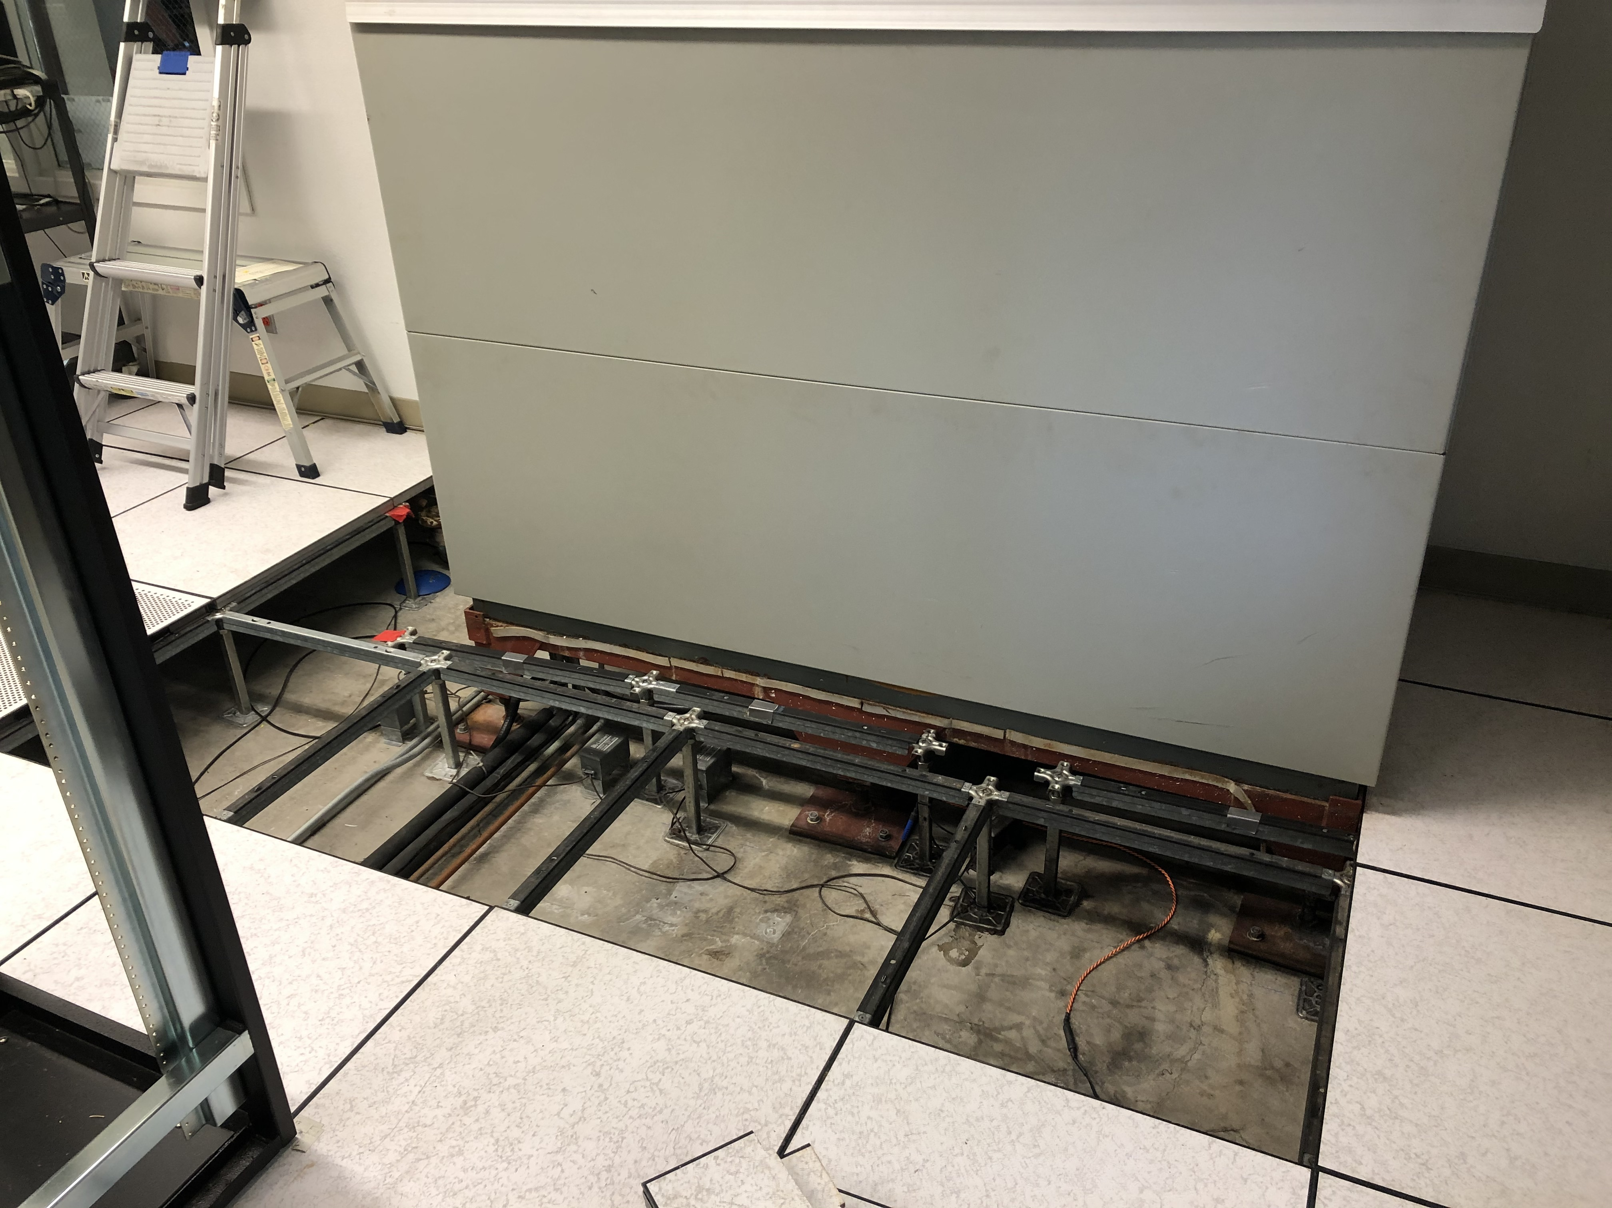
11in
Connector pipes

Slide 5
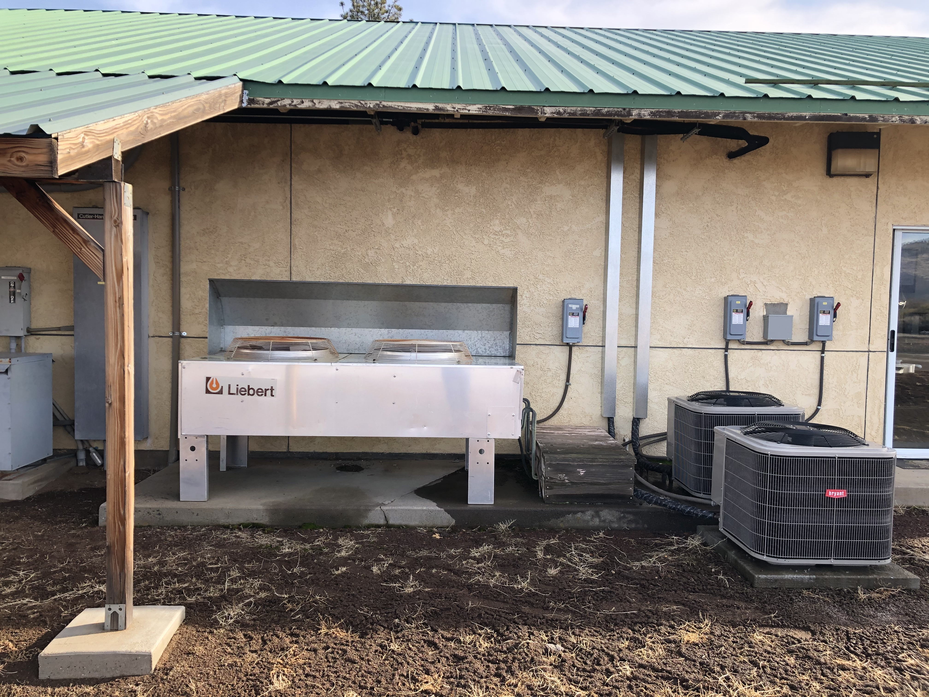
Condenser
Connector pipes contained within wood box

Slide 6
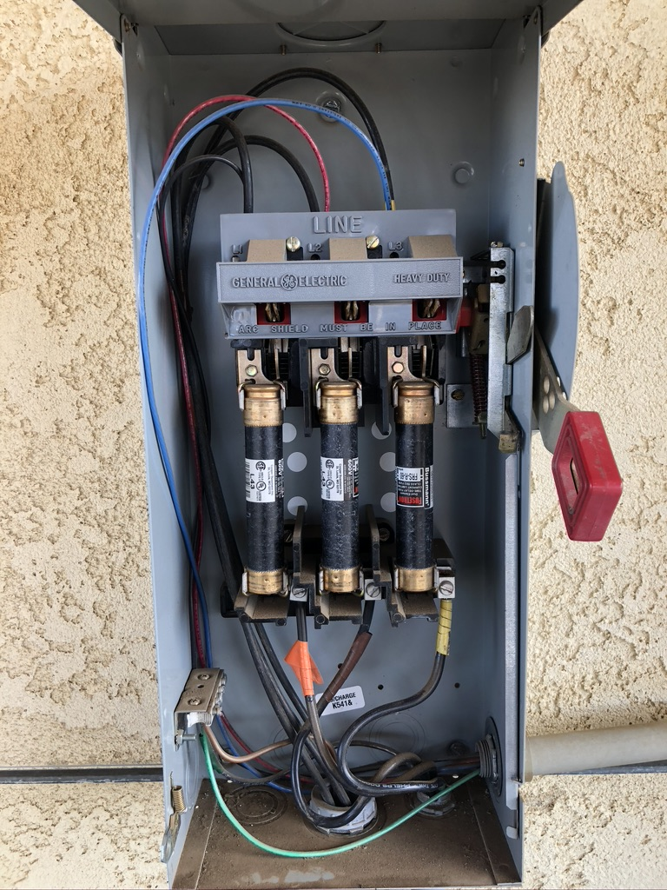
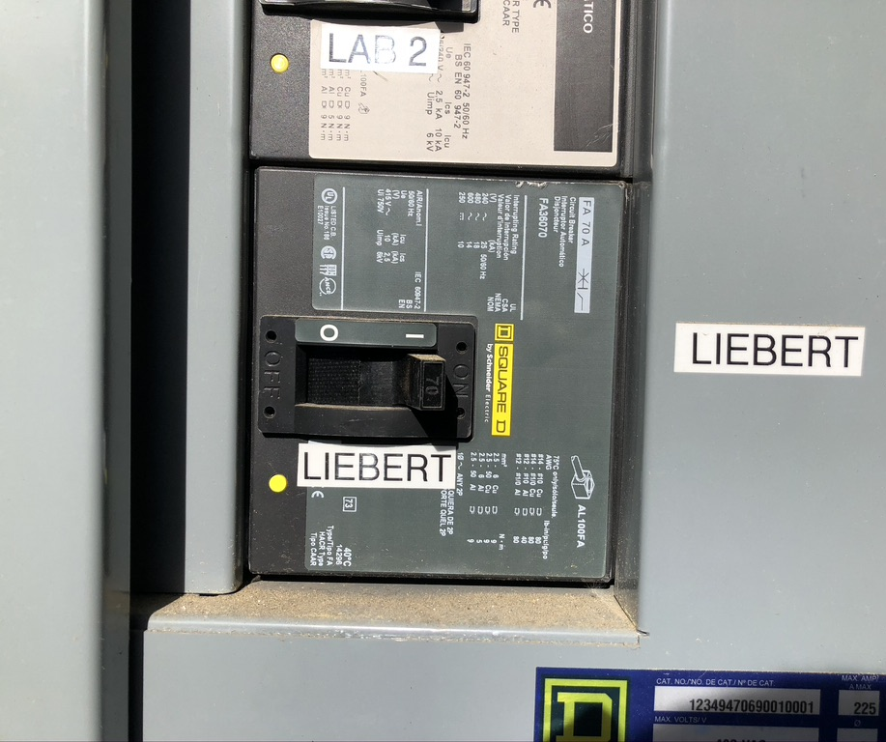
Circuit breaker main distribution panel,
approx. 60ft to the right of condenser unit. Wire Size #6
Circuit breaker outside SPR approx. 6 ft left of condenser unit (60A)
Wire Size in #6 Wire Size out #8
Wire size from power panel at generator is #6 to disconnect on Main Lab
Wire size from disconnect to machine is #8
Breaker size at power panel is 70 amp
Disconnect on Main Lab is 60 amp fused

Slide 7
~30ft
Location of Main Power distribution for HCRO

Slide 8
Wire size from power panel at generator is #6 to disconnect on Main Lab
Wire size from disconnect to machine is #8
Breaker size at power panel is 70 amp
Disconnect on Main Lab is 60 amp fused

Slide 9
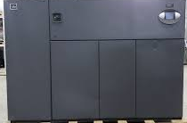
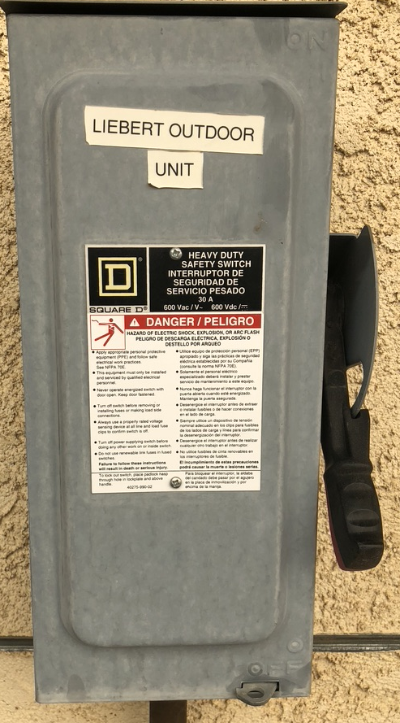
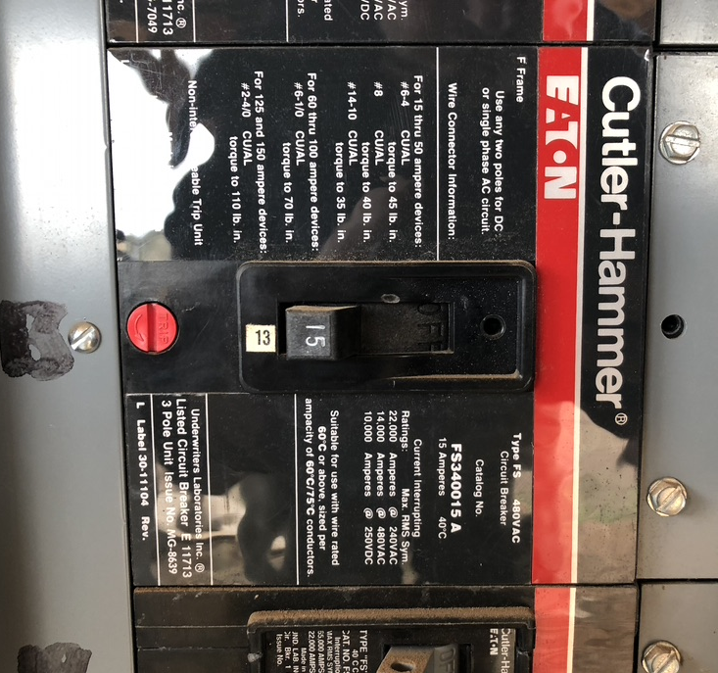
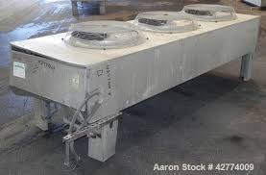
#6
#6
existing wire
new wire (approx. 50ft)
Existing conduit is 3/4 in
New AC unit
Location of Main Power distribution for HCRO
AC disconnect
new one required with 70A Fuse
#10
installation by HCRO
Connection to condenser
SPR Main Power: spare circuit breaker for outside unit (460V 3phase)
New condenser unit

Slide 10
#4
#6
new wire (approx. 150ft each)
total 450ft plus Ground
new wire (approx. 50ft each)
Existing conduit is 3/4 in
New AC unit
Location of Main Power replacement with 80A breaker
AC disconnect
new one required with 70A Fuse
#4
#12
Connection to condenser
Condenser disconnect
Reuse of old panel 15A fuse
New condenser unit

Slide 11
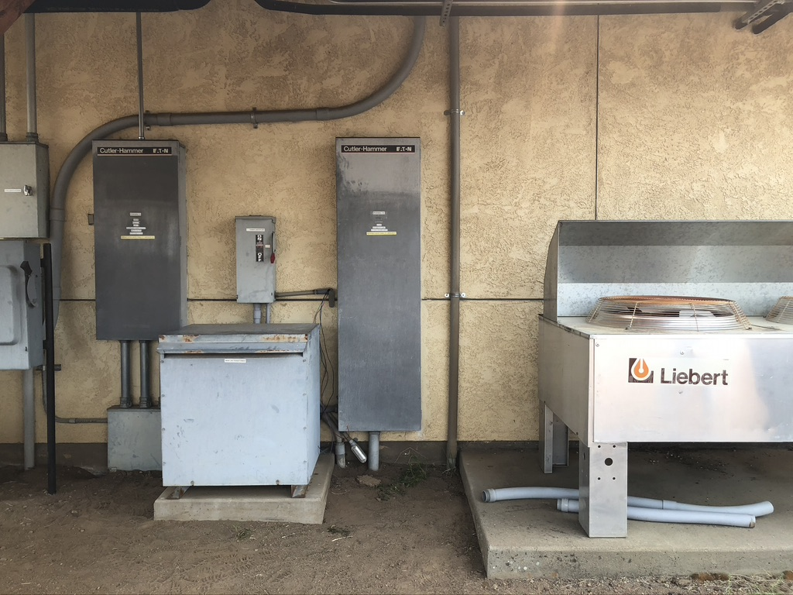
location for both disconnects,
inside unit and condenser

Slide 12
